Slide 1

Teen Leader
Training

Slide 2

Overview of LAUSD’s
Covered California Outreach and Education Project
“Covered California in LAUSD”
A project that provides outreach and education activities about Covered California and enrolling in health insurance

Slide 3

How does insurance work?
Insurance is a contract (called a policy) between you and the insurance company that says the insurance company will pay a portion of your expenses in case something happens (such as in the previous scenarios). There is car insurance, medical insurance, life insurance, homeowner’s insurance, etc.

Slide 4
How does insurance work?
Members pay a monthly (or semi-annual or annual) premium to the insurance company
The policy spells out what services the insurance company will cover and how much of the bill you have to pay out of pocket.
Health insurance: people can have “employer-based” health insurance through their jobs, or have coverage through a Covered CA plan, or pay for their own private insurance, or have a public insurance program through Medi-Cal

Slide 5
Why does health insurance matter
to all families?
Health care access is a human right
When you have access to primary prevention (vaccines, cancer, STD and diabetes screening) you avoid getting sicker and stay healthier longer
Having insurance can avoid a family falling into deeper poverty through a catastrophic incident
Students who are healthier do better in school

Slide 6
What is the Affordable Care Act?
The Affordable Care Act (ACA) is also known as ObamaCare. It is a Federal law that changes how some people get health care in the US.
Under ACA, insurance companies can’t deny anyone care because they’re sick now or have been sick in the past.
The ACA creates health benefits exchanges. In California, it is called Covered California.

Slide 7
What is the Covered California?
Covered CA is a new health insurance marketplace where you can compare and choose health plans
It can help people find out if they qualify for financial help to make insurance more affordable.
People can also find out if they’re eligible for low or no cost coverage through Medi-Cal.
Legal residents of CA who do not have health insurance from their employee or a government program can get coverage through Covered CA.

Slide 8

COUNTDOWN TO COVERAGE
Covered California 101
Ten (10) Essential Benefits
1. Ambulatory patient services
2. Emergency services
3. Hospitalization
4. Maternity and newborn care
5. Mental health and substance use disorder services

Slide 9
COUNTDOWN TO COVERAGE
Covered California 101
Ten (10) Essential Benefits
6. Prescription drugs
7. Rehabilitative services and devices
8. Laboratory services
9. Preventive, wellness services and disease management
10. Pediatric services, including oral and vision care.

Slide 10
Renewal and Changes to Plan
If you take no action, you will be automatically renewed with the same health plan. It’s still important to review your account because it’s likely that your premium amount or premium assistance will change in the new coverage year.

Slide 11

YouToons Video
http://kff.org/health-reform/video/youtoons-obamacare-video/

Slide 12

COUNTDOWN TO COVERAGE
The Countdown
Three (3) Ways to Get Assistance and Apply
 | ONLINE
 | Californians can apply on their own through the Internet. Simply go to www.coveredCA.com and click on the yellow “Start Here” button. Applicants need to create an account BEFORE beginning the application process.
 | OVER-THE PHONE
 | For personalized assistance, call the CHAMP HelpLine at (866) 742-2273. CHAMP is open Monday through Friday from 7:30 a.m. to 4:00 p.m. If you are ready to apply call Covered California at (800) 300-1506.
 | IN-PERSON
 | Call the CHAMP HelpLine (866-742-2273) and they can direct you to a Covered California Certified Educator or Certified Enrollment Counselor in your area. In-person assistance can also be found on www.coveredCA.com by clicking on “Find Help Near You” and then Clicking on “Find an Enrollment Counselor”.

Slide 13
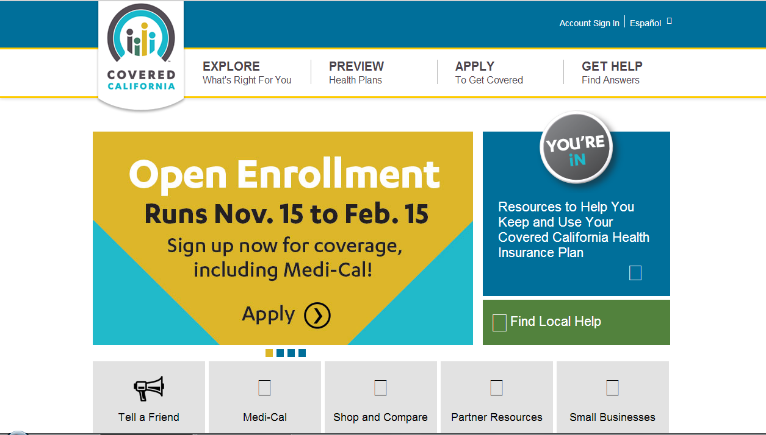
PRACTICAL STEPS
Covered CA Website
www.coveredca.com

Slide 14
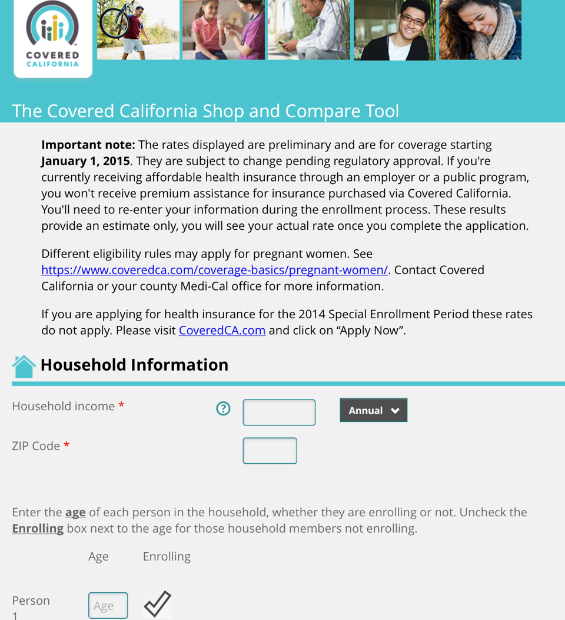
PRACTICAL STEPS
Covered CA Online Shop and Compare tool
www.CoveredCA.com/shopandcompare

Slide 15
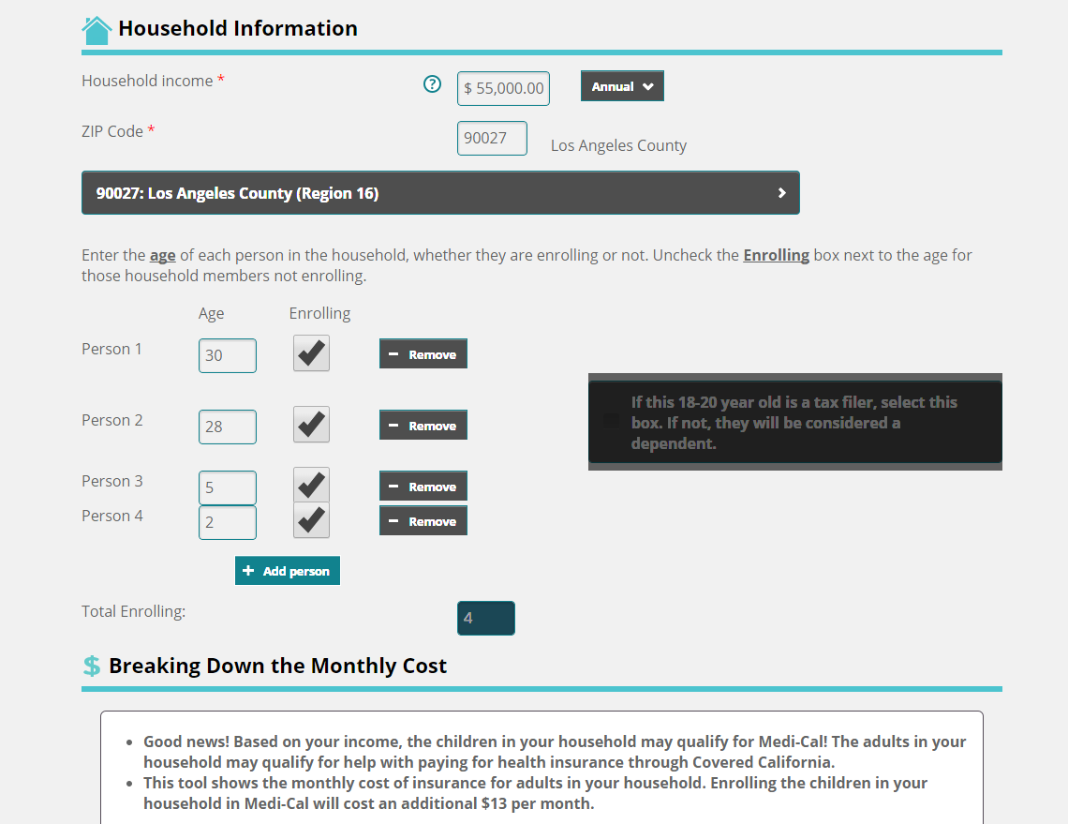
PRACTICAL STEPS
Covered CA Online Shop and Compare tool

Slide 16
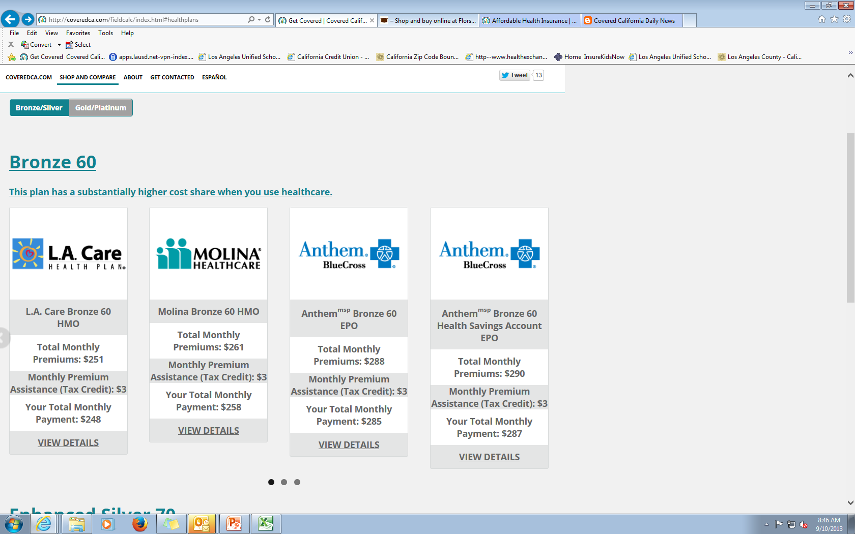
Covered CA Online Shop and Compare tool
Example:
#

Slide 17
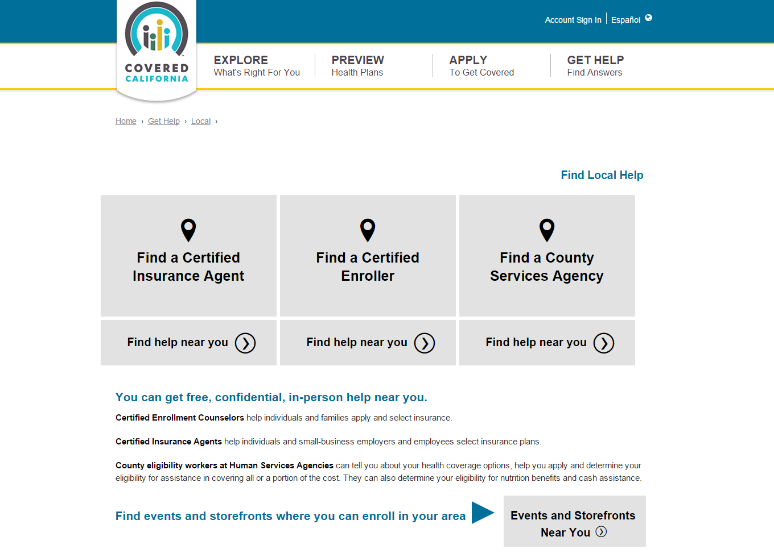
Covered CA Website
Find Local Help
https://www.coveredca.com/get-help/local/

Slide 18
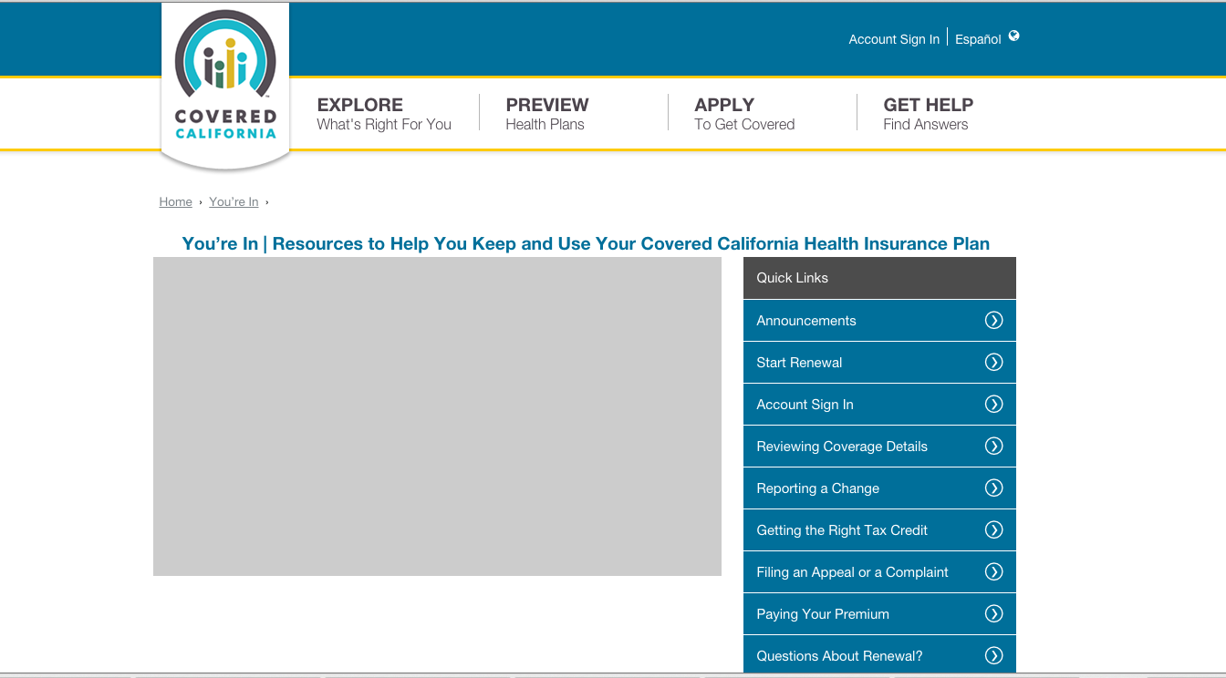
PRACTICAL STEPS
Renewal
https://www.coveredca.com/youre-in/

Slide 19
PRACTICAL STEPS
Renewal
To start the renewal process, sign in to your account on CoveredCA.com. Make changes for 2016 on the “Renewal Summary" page by clicking the “Edit" buttons. If you do not take any action your account will be automatically renewed and no changes will be made. REMEMBER!! If you are not on a health insurance plan your family will be FINED.

